Slide 1

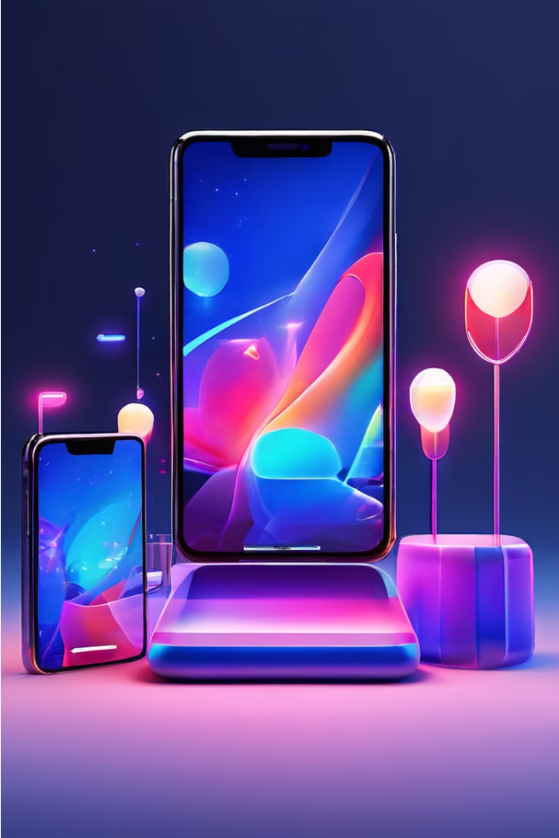
Flipkart Mobile Sales Overview
Flipkart offers a variety of “Smartphones” for leading brands, so it's the first choice when buying mobile phones online. A SlideShare from Flipkart that summarizes learnings and trends to drive more mobile sales.
By Amit Ghosh

Slide 2
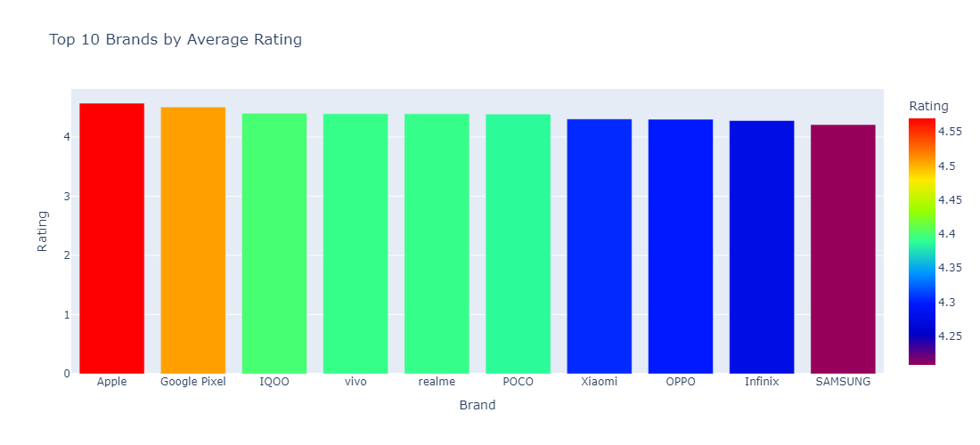

Top 10 Brands Upon Customer Ratings

Slide 3
Top 3 Brands Upon Customer Ratings
Top Brands
Customer Ratings
Insights
The most popular (Top Three) mobile brands on Flipkart
Flipkart customers have issued some of the following feedback. Brands known for their impeccable product quality, performance, and user experiences such as IQOO, Vivo, or Apple also go through reviews.
Here, we compared top brands of products with customer ratings to understand what a consumer wants and accordingly offer the same on Flipkart.
Apple Rating = 4.6
Google Pixel = 4.55
IQOO = 4.4

Slide 4
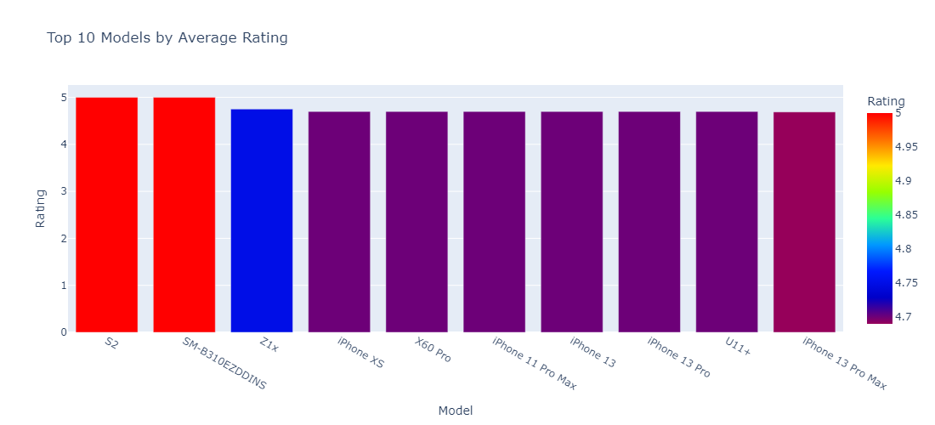
Top 10 Models Upon Customer Ratings

Slide 5
Top Models Upon Customer Ratings
Top Models
Customer Ratings
Insights
The most popular (Top Three) mobile brands on Flipkart
Over the years, customers Flipkart has given 5-star ratings to many brands and reviewed products from top-rated brands such as Vivo & Apple for their superior product quality, performance, and user experience.
Examining where top brands intersect with customer ratings, Flipkart can discern styles that resonate and serve up an assortment of product selections tailored to its ever-evolving audience.
1) Vivo(S2) & Samsung(SM-B310EZDDINS) = 5
2) Vivo(Z1x) = 4.75
3) Apple(iphone xs, iphone 11 Pro max,
iphone 13, iphone pro),
Vivo(X60 Pro) = 4.7
4) Apple(iphone 13pro max) = 4.68

Slide 6
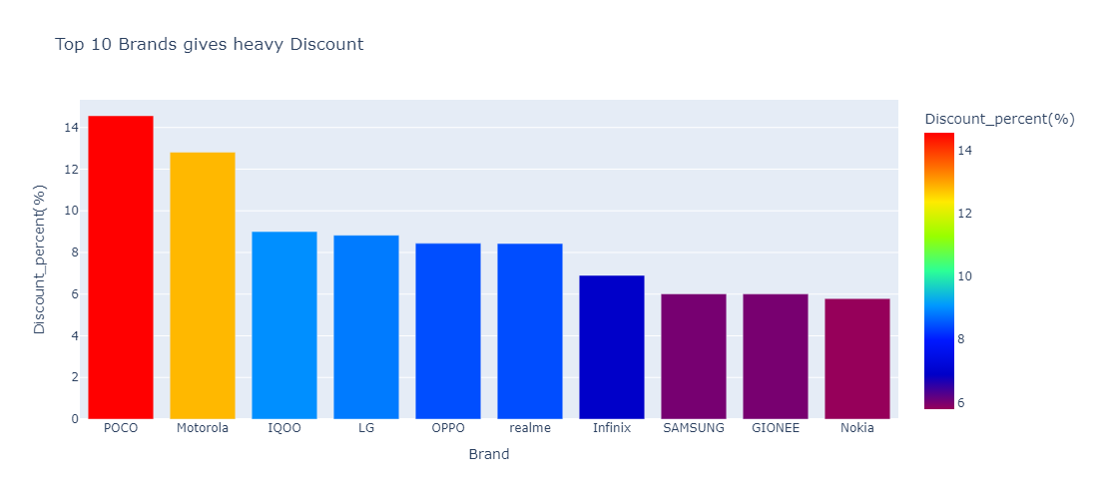
Discounts Offered by Brands

Slide 7
Discounts Offered by Brands
1
POCO Discounts (14.56%)
2
Motorola Discounts (12.9%)
The most popular smartphone brand POCO often delivers large discounts on its smartphones being a value for money offering.
Motorola uses its market power to run sweet discounts and bundle offers, especially for its mid-range or flagship smartphones
3
IQOO Discounts (9%)
4
OPPO Discounts (14.56%)
iQOO, a new entrant in the Indian smartphone market is generally seen bringing flash sales and limited-time offers to increase its one of many range smartphones and set up grounds for itself.
Oppo offers competitive pricing and bundle deals to attract customers on Flipkart given its focus on camera-centric smartphones

Slide 8



Pricing Trends: Expensive vs. Budget Brands
High Range Brands:
OPPO
HTC
Google Pixel
LG
ASUS
Nokia
Apple
SAMSUNG
Motorola
Xiaomi
Vivo
Mid Range Brands:
IQOO
Realme
GIONEE
Lenovo
POCO
Low Range Brands:
Infinix
Flagship Segment
Premium brands like Apple, Samsung, and Google Pixel are known for higher prices for their flagship models, catering to customers seeking the latest cutting-edge technology and features.
Mid-Range Segment
Brands like IQOO, POCO, and Lenovo have managed to maintain a strong presence in the mid-range segment, offering a compelling balance of performance and affordability.
Budget Segment
Brands like Infinix have found success in the budget-friendly segment, providing value-for-money smartphones that target cost-conscious customers.

Slide 9
Conclusion and Key Takeaways
Top Brands
Customer Ratings
Discounts
Pricing Trends
Apple
Vivo, Samsung
POCO
Flagship, Mid-Range, Budget
Flipkart's mobile sales landscape is characterized by a diverse range of top brands, customer preferences, and pricing. By understanding these key insights, Flipkart can optimize its offerings, and evolving consumer needs, and maintain its position as a leading e-commerce platform for mobile device sales.

